Slide 1
O list Data Analysis
Using data analytics to understand customer satisfaction and identify business improvement opportunities.

Slide 2
Business Problem and Objectives
Business question: What factors influence customer satisfaction and lead conversion success?
Four objectives:
Analyze customer review-score distribution.
Identify the highest-converting lead sources.
Determine product categories associated with negative reviews.
Examine the relationship between delivery time and review scores.
Identify actionable opportunities to improve customer experience and business performance.

Slide 3
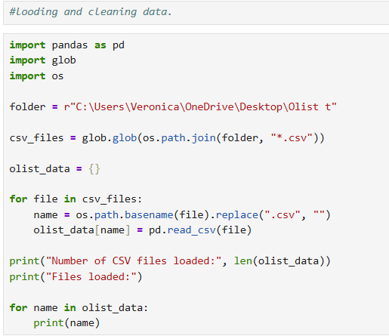
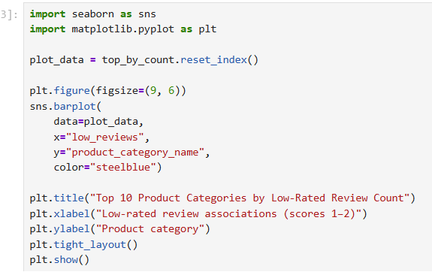
Data and Methodology
Tools used: Python, Pandas, Matplotlib, Seaborn, and Jupyter Notebook.
Steps performed:
Loaded and inspected CSV datasets.
Checked missing values, duplicates, and data types.
Merged relevant order, review, and product datasets.
Calculated summary statistics and conversion rates.
Created charts to communicate findings.
Data cleaning and analysis transformed raw data into meaningful business insights.

Slide 4
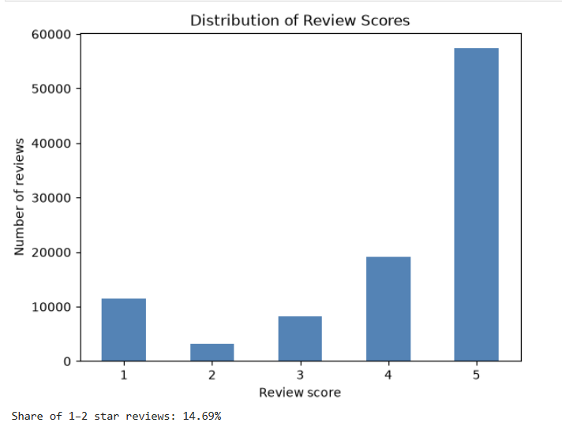
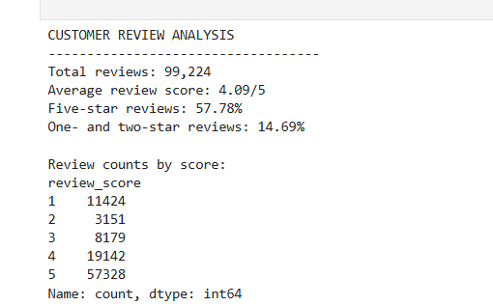
Customer Review Analysis
Average review score: 4.09/5
Five-star reviews: 57.78%
Total reviews analyzed: 99,224.
One- and two-star reviews: approximately 14.69%.
Customer feedback was generally positive, but some customers were dissatisfied.
Visual: Bar chart showing the number of reviews for each score from one to five stars.

Slide 5
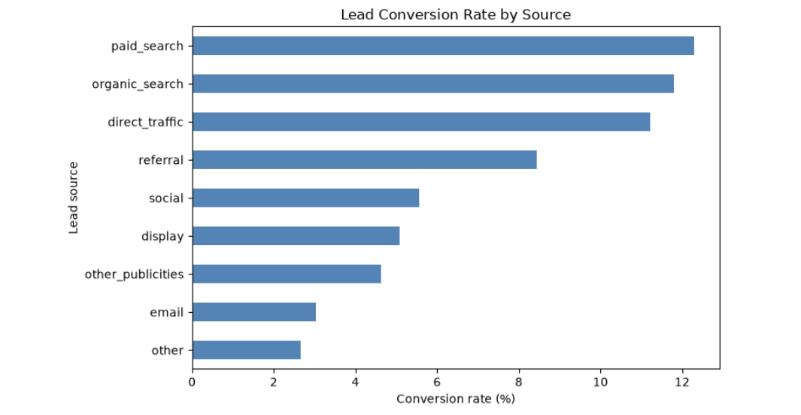
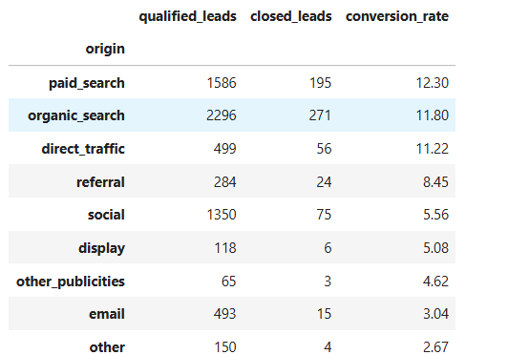
Lead Conversion Analysis
Conversion rate = closed leads ÷ qualified leads × 100
- Paid search had the highest conversion rate among identifiable sources.
- Organic search generated the most closed leads: 271.
- Email and other lower-converting sources may need further investigation.
Visual: Horizontal bar chart ranking conversion rates.
Business implication: Assess marketing channels using conversion rates, lead volumes, acquisition costs, and revenue.

Slide 6
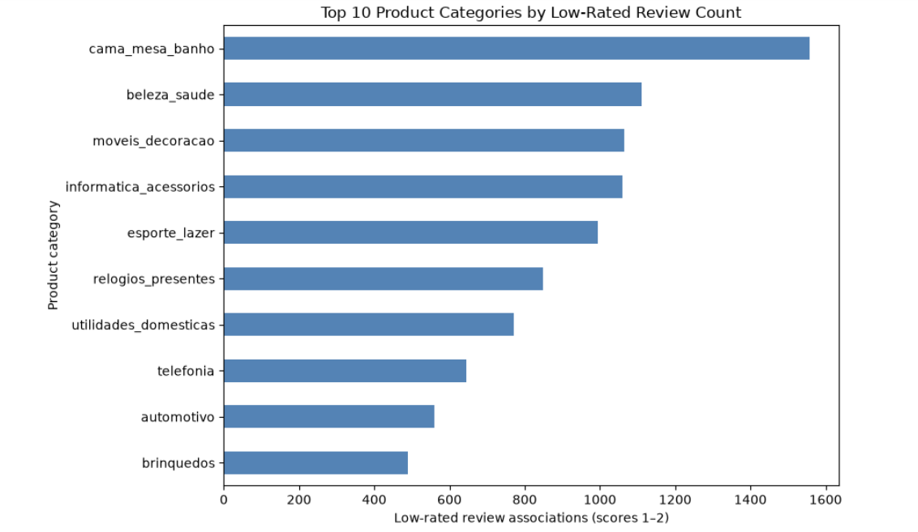
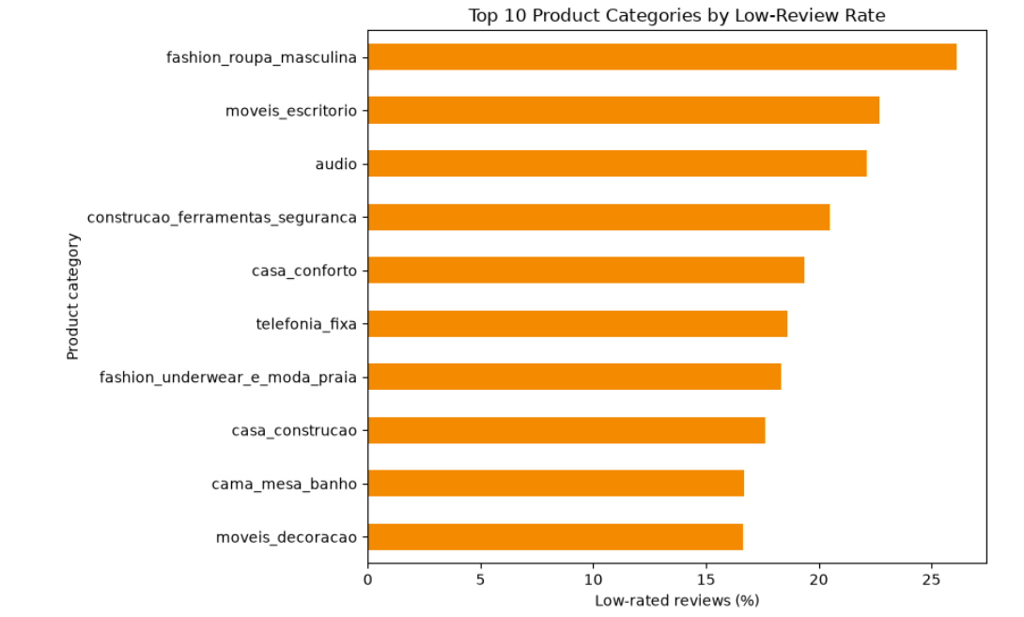
Product Categories and Negative Reviews
Cama_mesa_banho(Bed, table and bath) had the highest count of low-rated review associations among the categories shown in the analysis.
Other categories with substantial low-rated review counts included health and beauty(beleza_saude), furniture and décor(moveis_decoracao), and computers and accessories(informatica_acessorios).
Men's fashion(fashion_roupa_masculina), office furniture(moveis_escritorio), and audio appeared among categories with relatively high low-review rates in the filtered comparison.
Visuals: low-rated review counts and low-review rates.
Business implication: Investigate customer comments, product quality, seller performance, and the accuracy of product descriptions. Counts and rates measure different things.

Slide 7
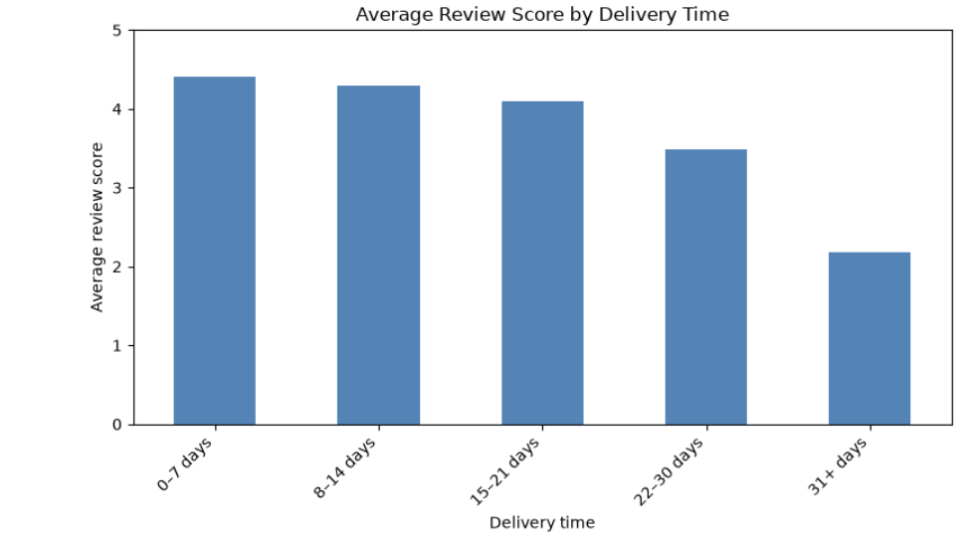
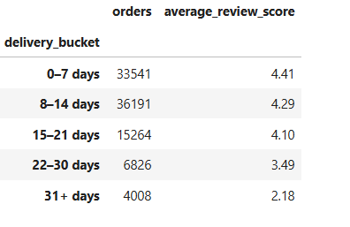
Delivery Time and Customer Satisfaction
Finding: Average review scores declined as delivery time increased, with a sharper drop after 21 days.
Business implication: Investigate delays, improve shipment tracking, and proactively communicate delivery changes. This is an association, not proof of causation.

Slide 8
Recommendations and Conclusion
Four recommendations:
Reduce delivery delays and improve customer communication.
Investigate recurring negative reviews in priority product categories.
Evaluate high-performing marketing sources and improve weaker channels.
Monitor customer satisfaction and operational performance regularly.
Conclusion: The analysis demonstrates how Python and visualization can support evidence-based decisions about customer experience, marketing, and logistics.

